Slide 1
Review 3
Gas Agency System

Slide 2
Team Members
Roll Number | Name
2110030150 | B V V L N Bhargav
2110030153 | Jaina Vamshi
2110030212 | Jatin Mishra
2110030293 | U Sai Subrahmanyam

Slide 3
Objective
Problem Statement Most of the LPG stations in Rural areas often experience long queue of people spending several hours waiting to buy gas. This problem of time wastage at the stations has persisted for several years

Slide 4
What is Gas Agency System?
The system show us the work of the gas agency. It provide the connection of new gas refill. And it also exchange the full refill instead of empty refill. For that it have the customer all information. It can also provide different tools related to the gas department. Like regulators,hotplate, lighters, tubes etc.

Slide 5
Data Set Collection
User Table :
User{u_ID,u_Name,u_Username,u_Password,u_gender,u_email,u_contact,u_city}
Gas Table :
Book{ID, Gas_Name, Gas_desc, Gas_Price, Gas_Qty}
We will use SET, DICTATIONARY, LIST and LIST WITH DICTATIONARY and SET.

Slide 6
Cart Table :
Cart{Cart_ID,Book_ID,User_Name,Cost,Book_Name,Quantity}
Checkout Table :
CheckOut(Order_ID,Cart_ID,Order_Date,Total_Amount}

Slide 7
Proposed System
Problem Statement Most of the LPG stations in Rural areas often experience long queue of people spending several hours waiting to buy gas. This problem of time wastage at the stations has persisted for several years.
Talking about the current system which presently used in the institutes is basically manually working or even if it is computerized restricted to a place or building thus all work of maintenance is also done in the same building. So, we can say that the Existing system of Gas Booking System works computerized in a building or manually with pen-paper.

Slide 8
TOOL SETUP
Star UML
StarUML is a software engineering tool for system modeling using the Unified Modeling Language, as well as Systems Modeling Language, and classical modeling notations. It is published by MKLabs and is available on Windows, Linux and MacOS. StarUML. Developer(s)

Slide 9
My SQL[Back-End] :
To develop any system along with the back-end tools which provide access to the database and also solves the database queries like oracle, to make a system interactive with the user the use of front-end tools comes into the picture. The front-end tools make the user interface with the system easier and also provide a user-friendly environment to the system.

Slide 10
This rich language enables you to develop many different types of applications. You can create you can create programs that intersect with the hardware.
It is a programming language used to create window base application. Visual Basic is an old BASIC (Beginners All-purpose Symbolic instruction code) language. It makes it very easy to get the user interface portion of your application up and running.

Slide 11
Hundreds of functions and latest technological advances have been added to the language to make it an industrial – strength development environment suitable for almost my type of windows application. This is especially true with the advent of internet programming and object oriented programming.
Microsoft Visual Basic 6.0 is one of the front-end tool provided by Microsoft Inc. Microsoft Visual Basic 6.0 provides a fast way to develop applications for Microsoft Windows. As a front-end tool Microsoft Visual Basic 6.0 provides the G.U.I interface to the user and it is supposed to be one of the beast front-end tools used today.

Slide 12

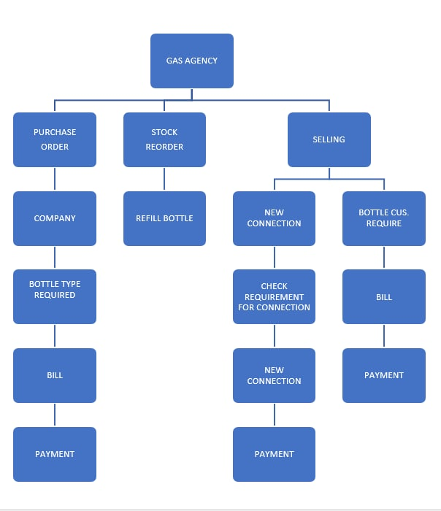
IMPLEMENTATION FLOW CHART

Slide 13
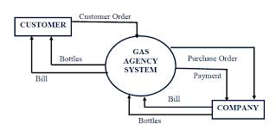
Data Flow Diagram(DFD)

Slide 14
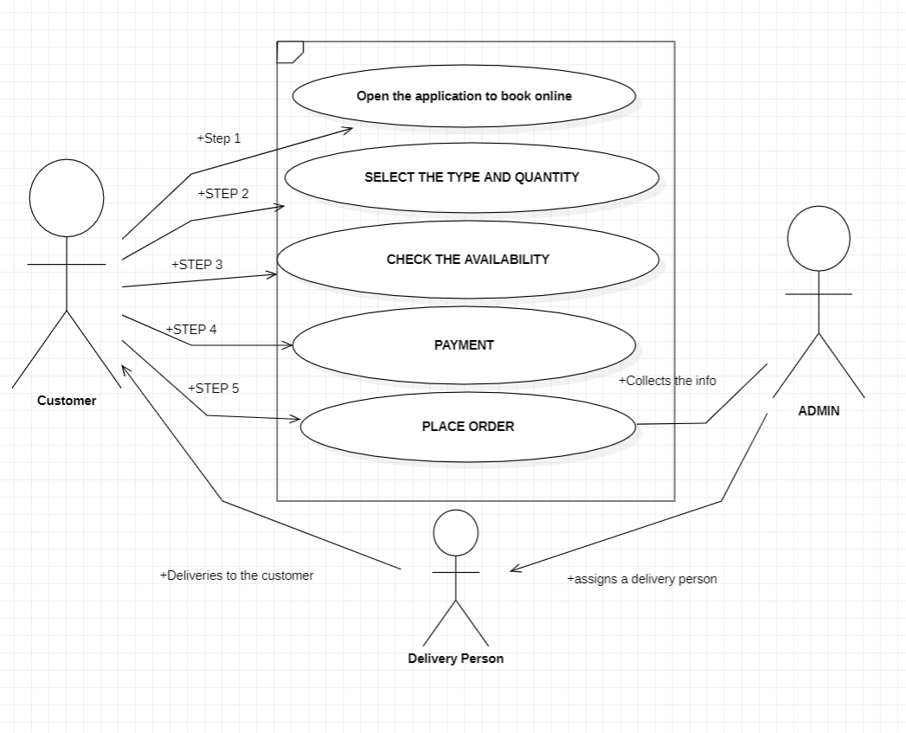
Use Case

Slide 15
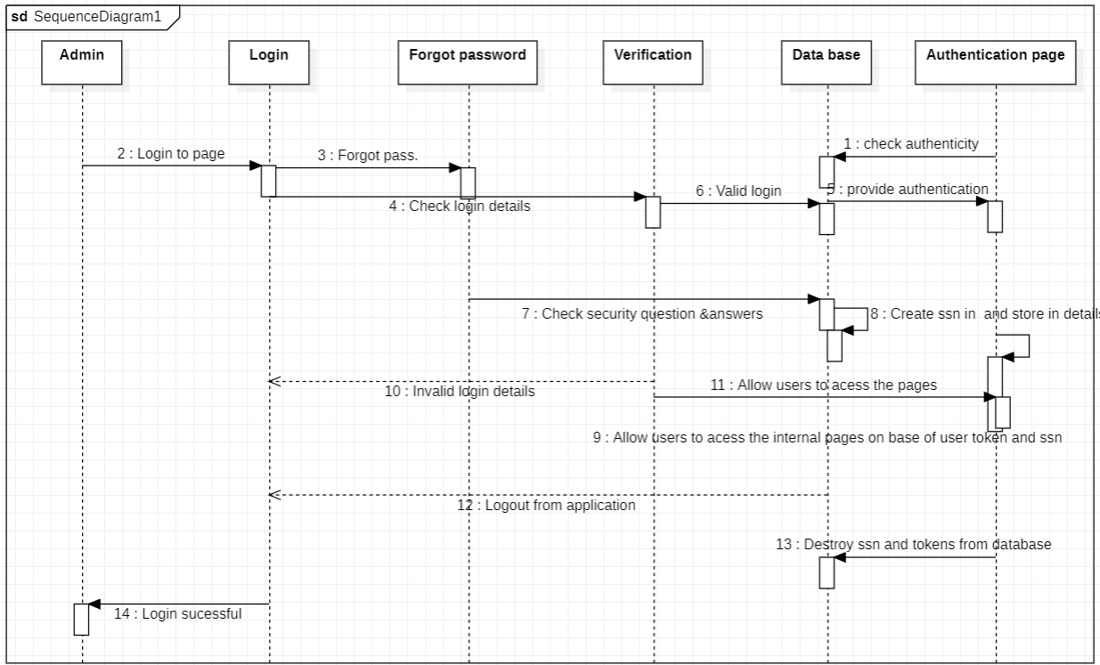
Sequence Diagram

Slide 16
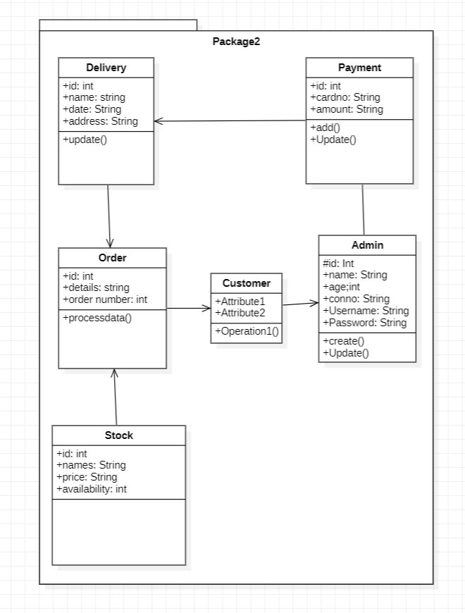
Class Diagram

Slide 17
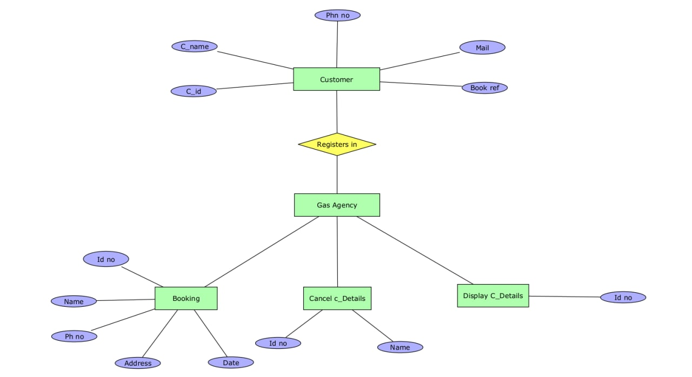
ER DIAGRAM

Slide 18
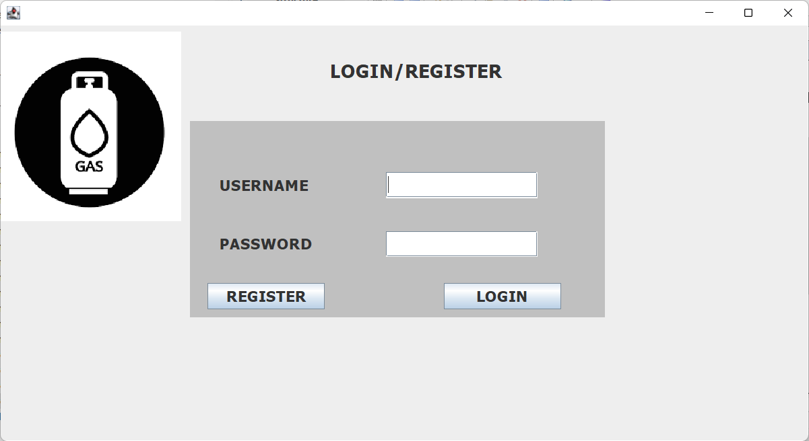
Login Page

Slide 19
Tools Setup
1. Python(language commands).
2. PyGUI (which provides a frame to access).
3.MySQL [DBMS(for records management)].
4. Pycharm (For implementation of code).
5.Terra_er and STARUML(to get workflow diagrams).

Slide 20
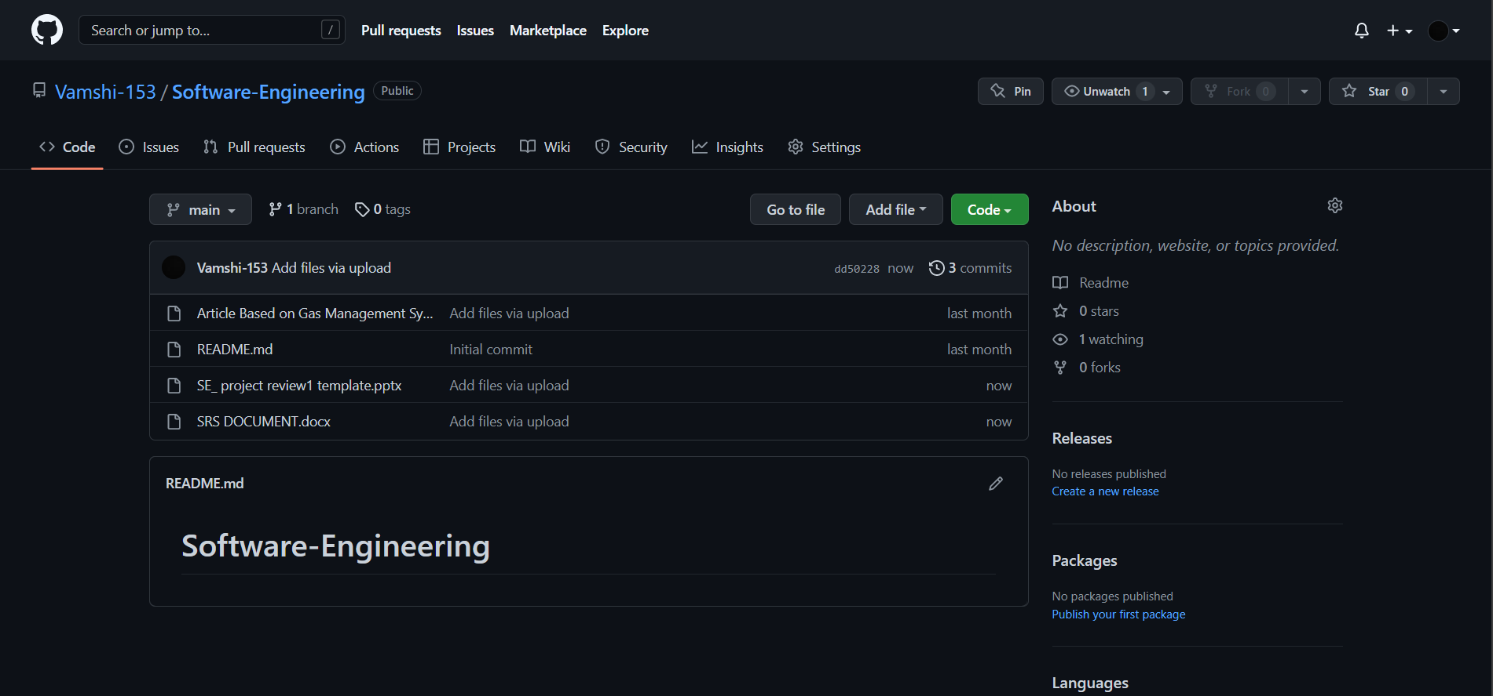
Git-Hub Commits

Slide 21
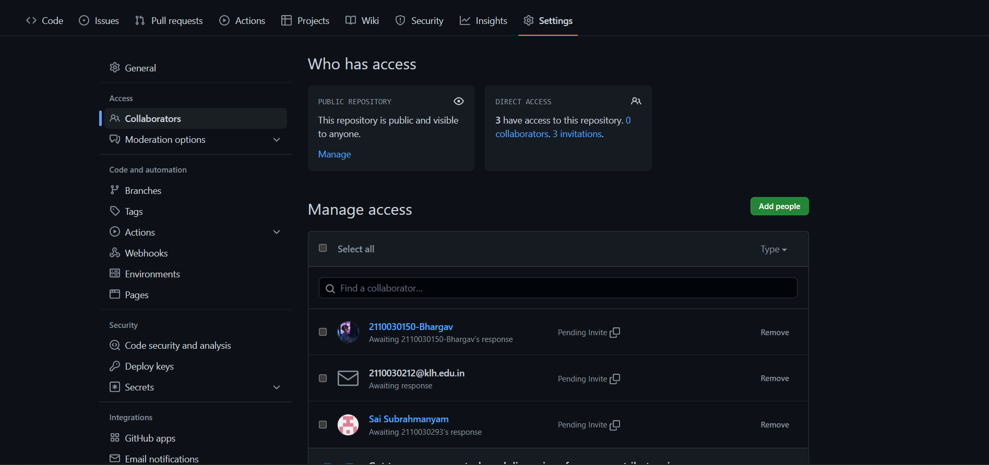

Slide 22
THANK YOU

